Slide 1
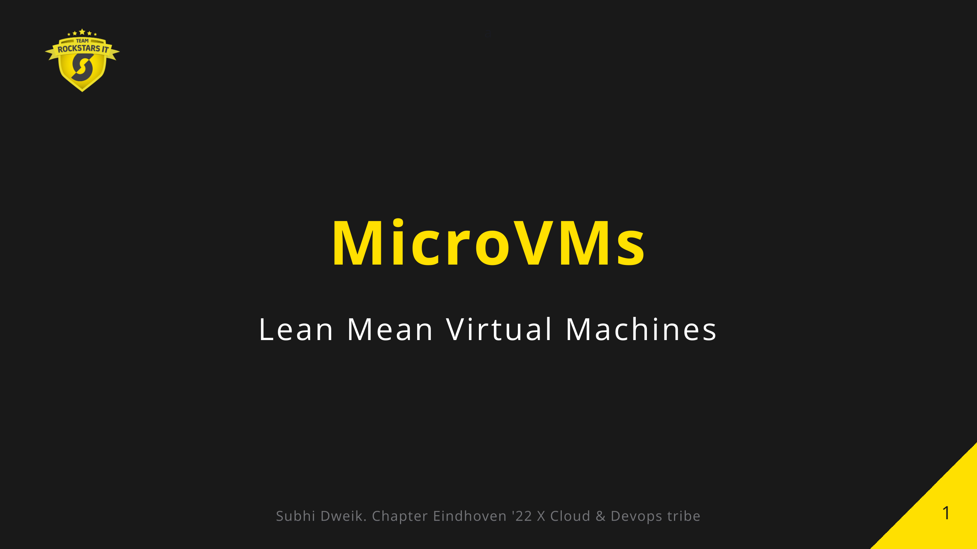

Slide 2


Slide 3


Slide 4
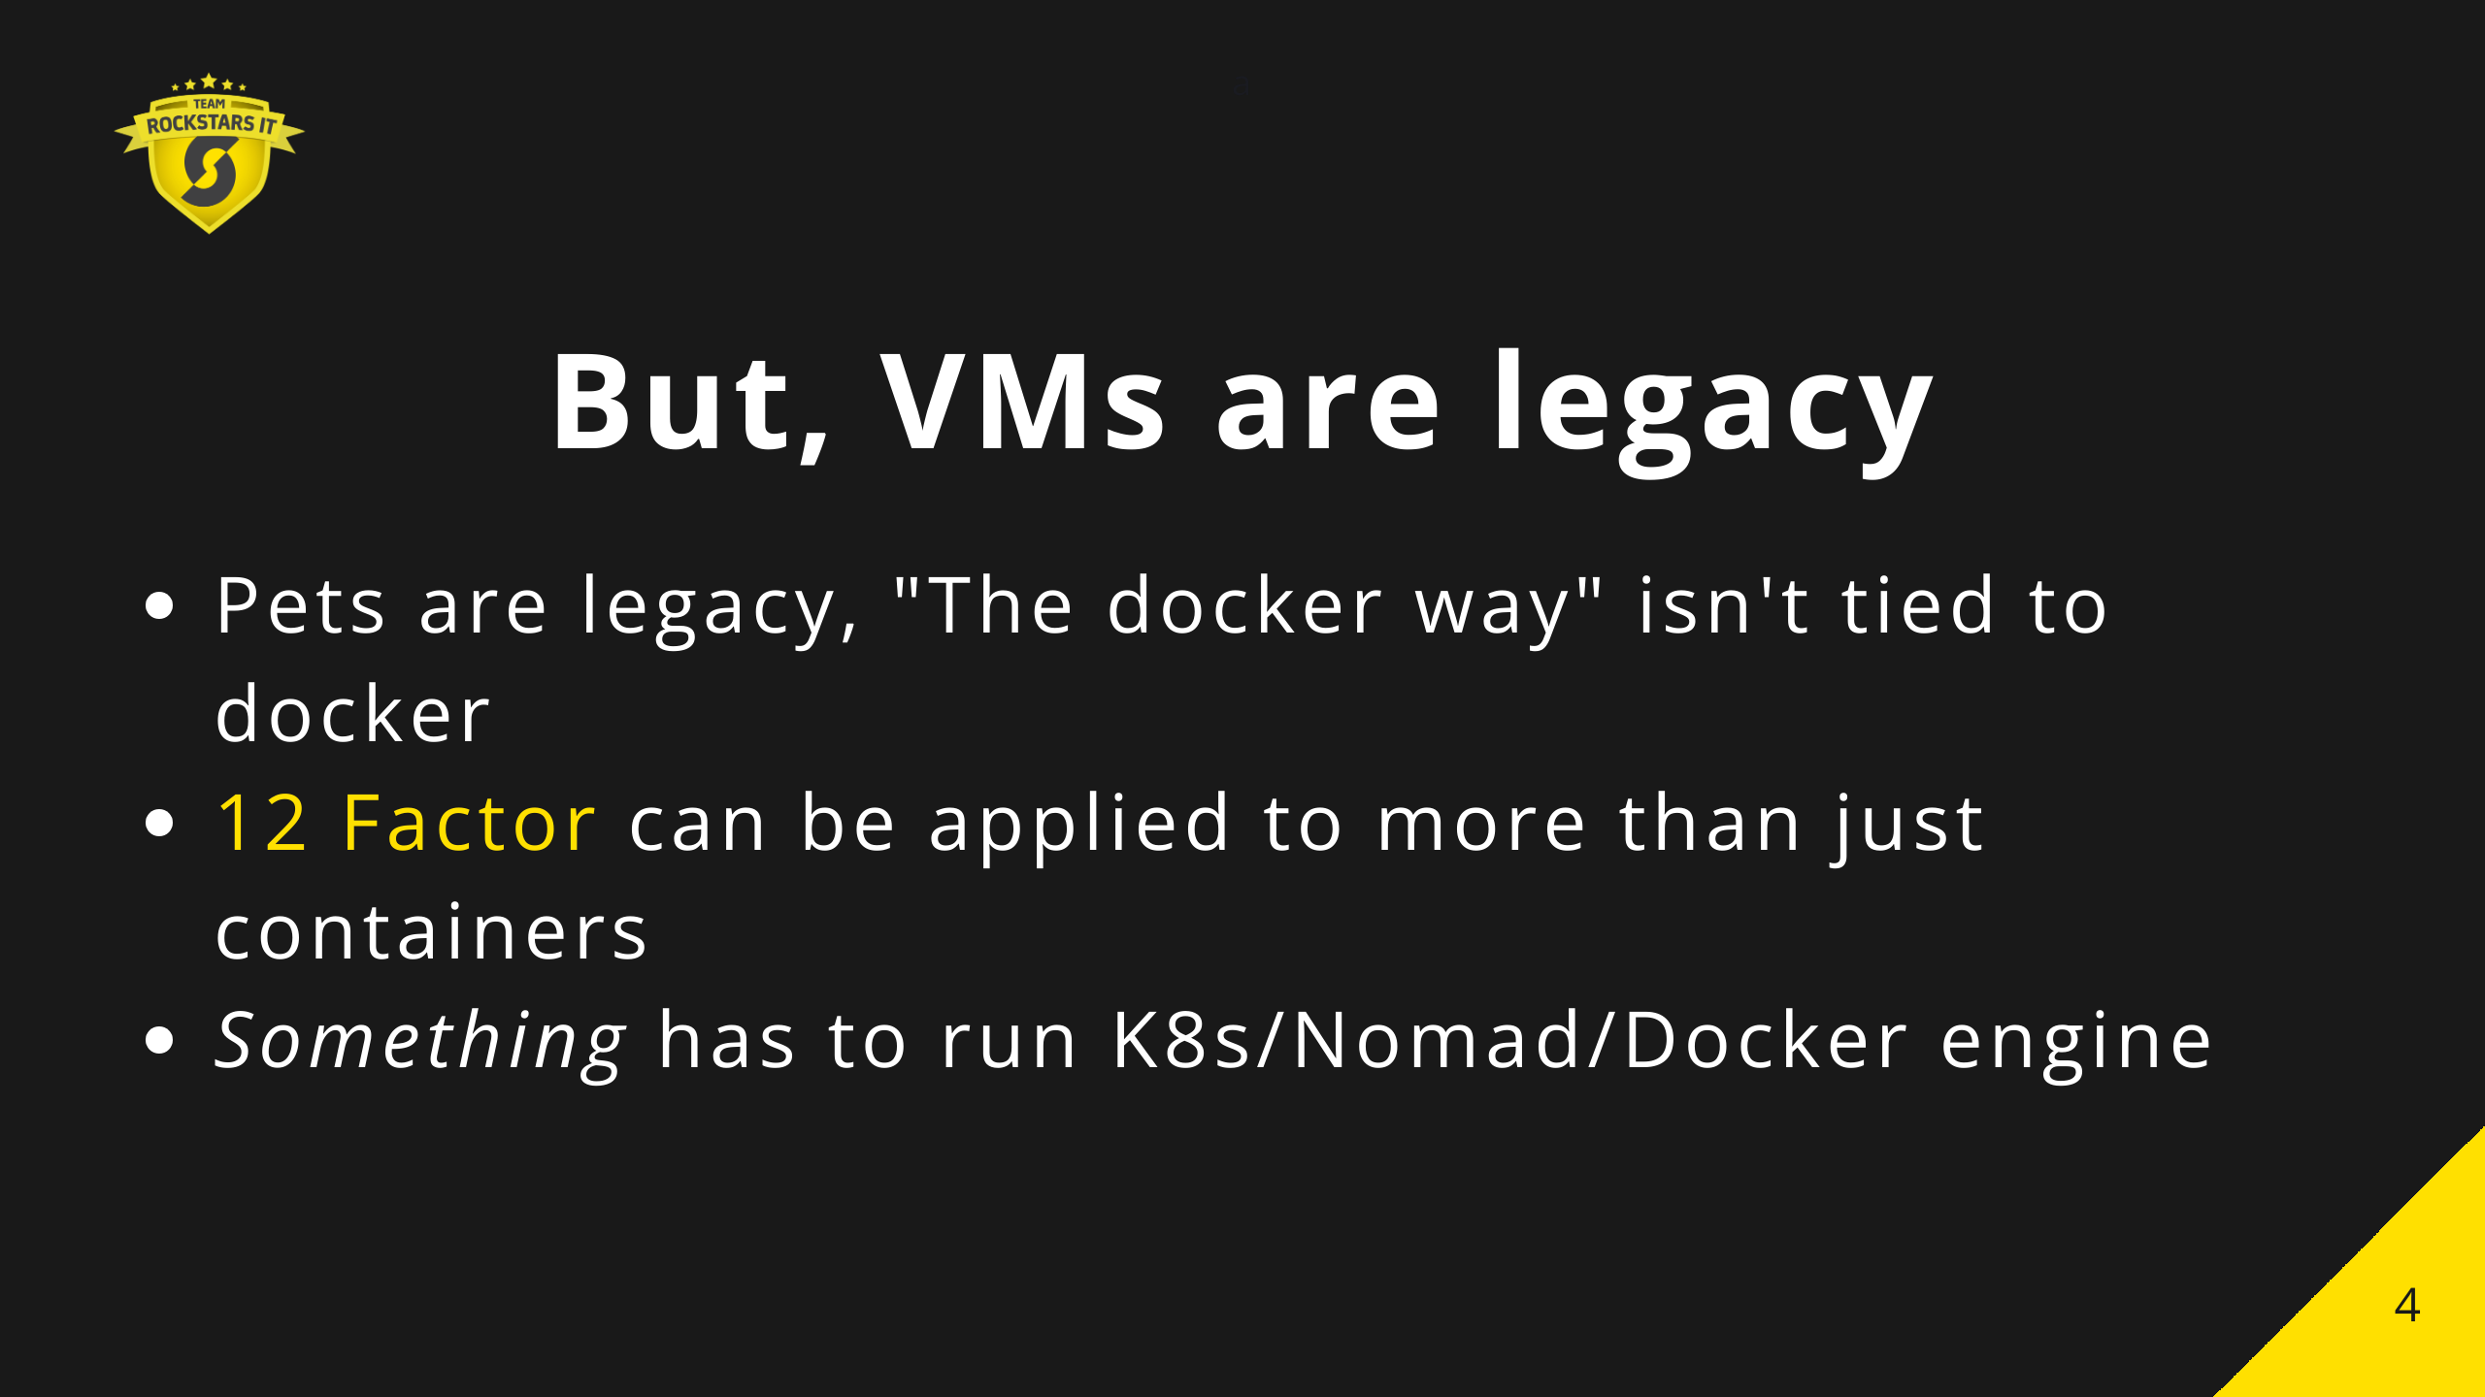

Slide 5
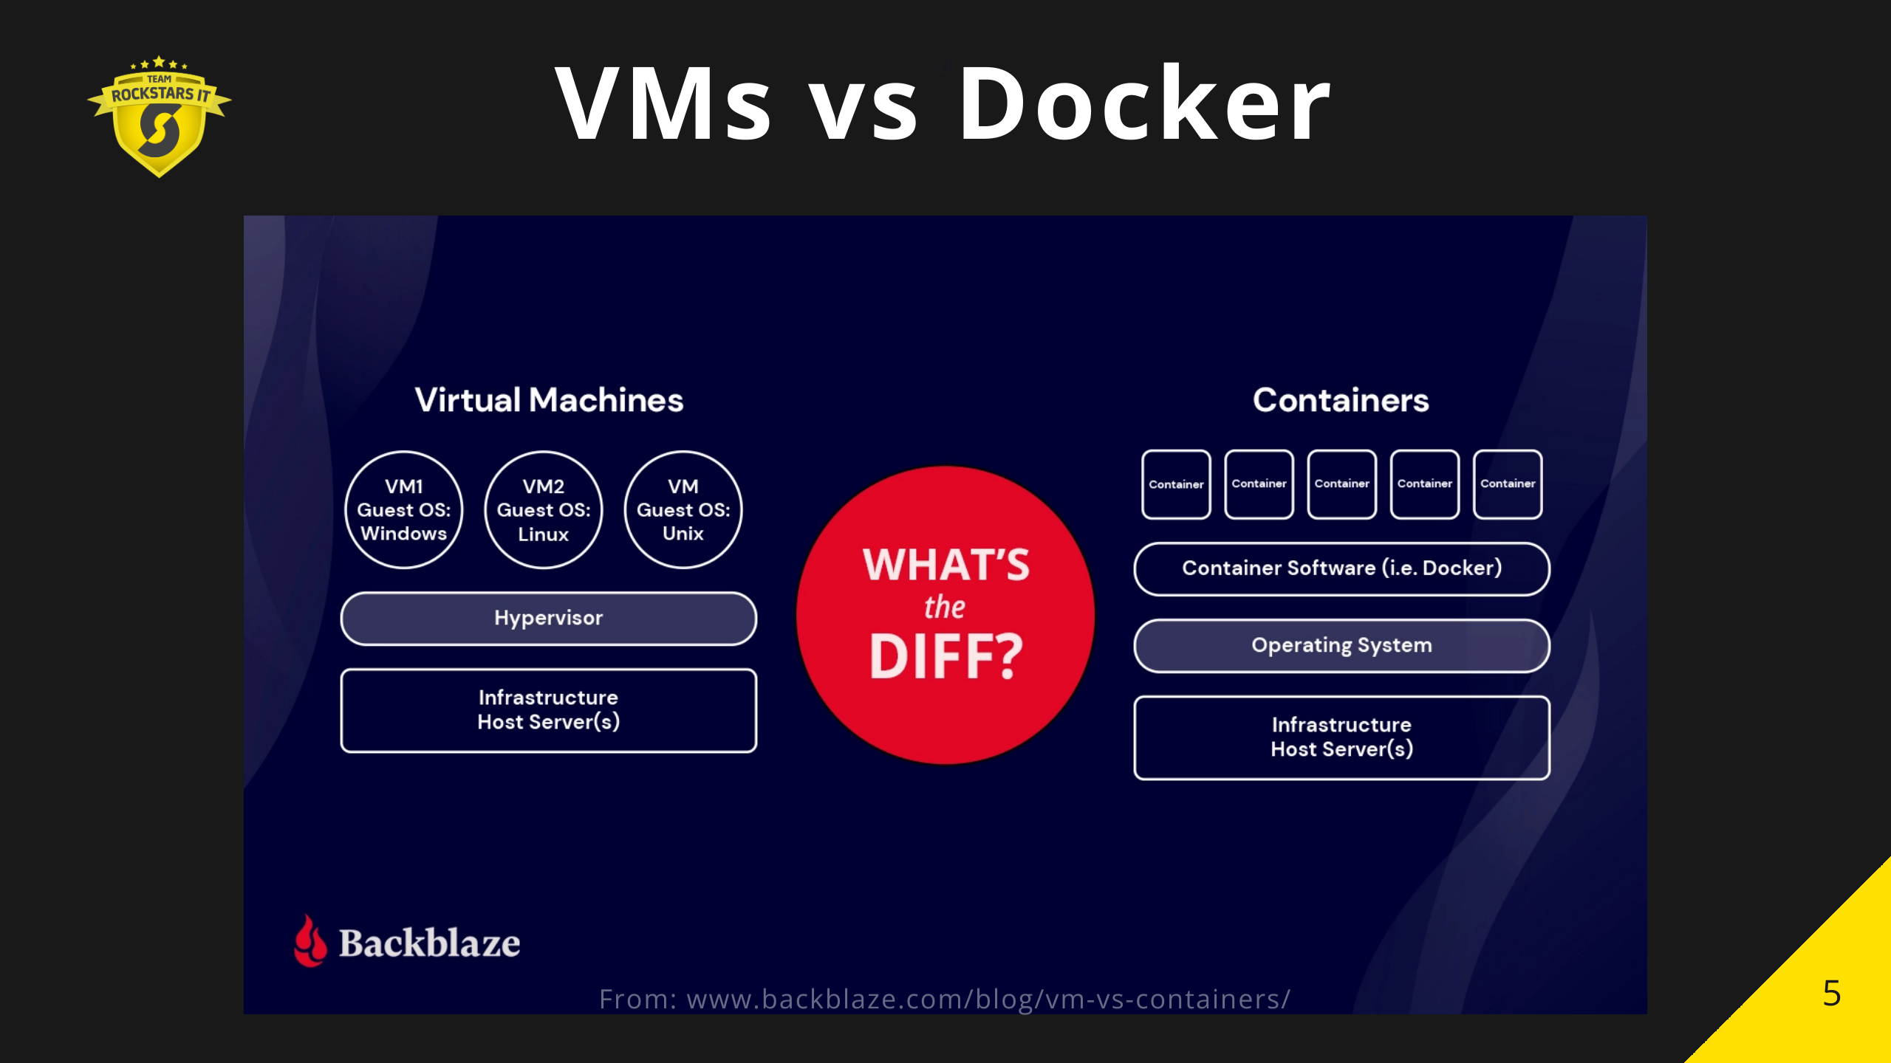
Notes:
Docker is essentially CGroups and a chroot
vms give far more isolation

Slide 6
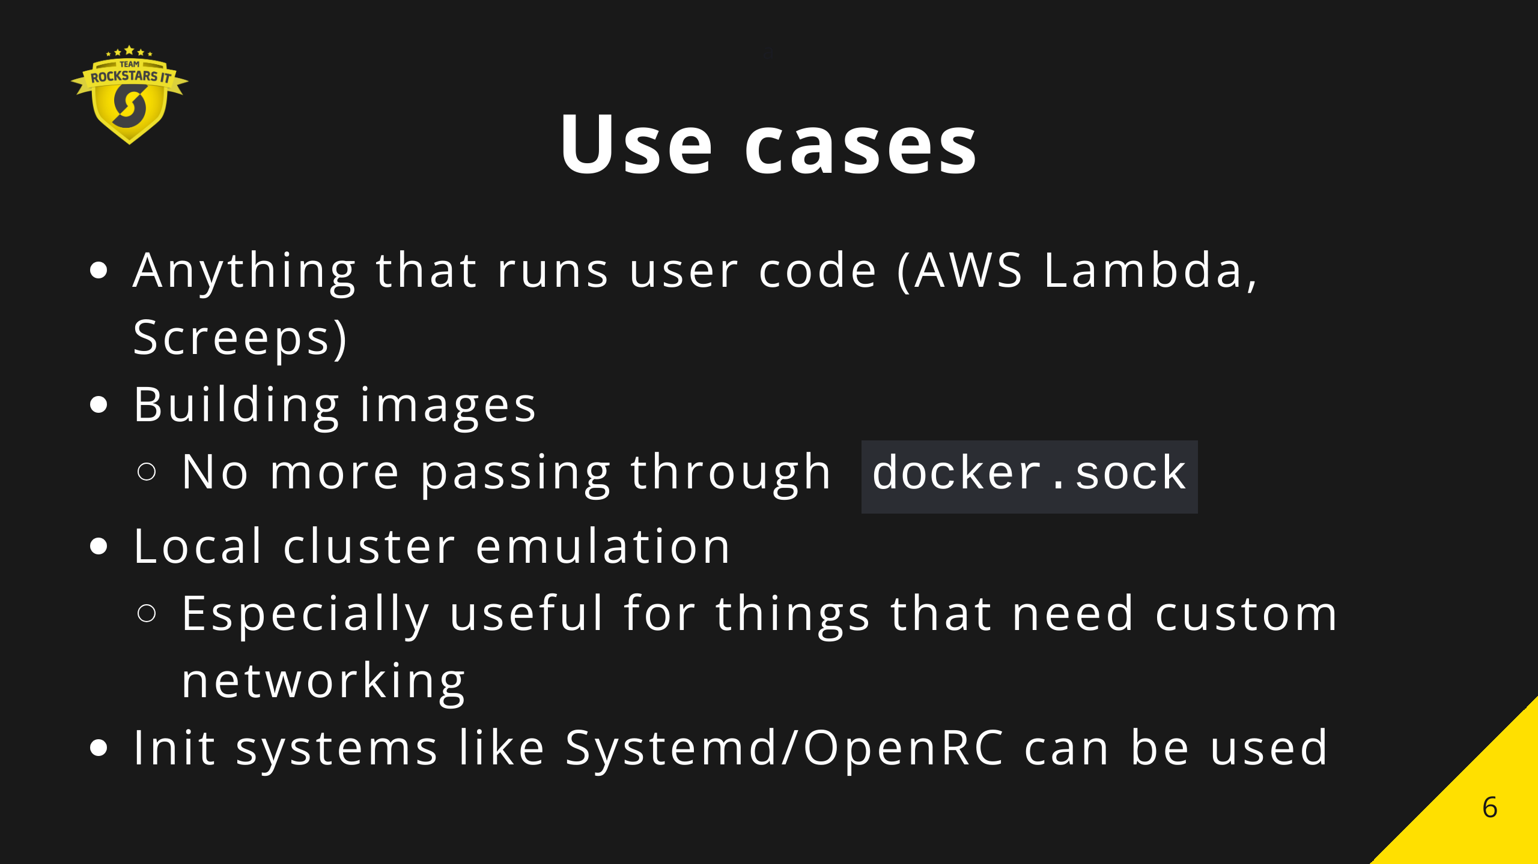

Slide 7
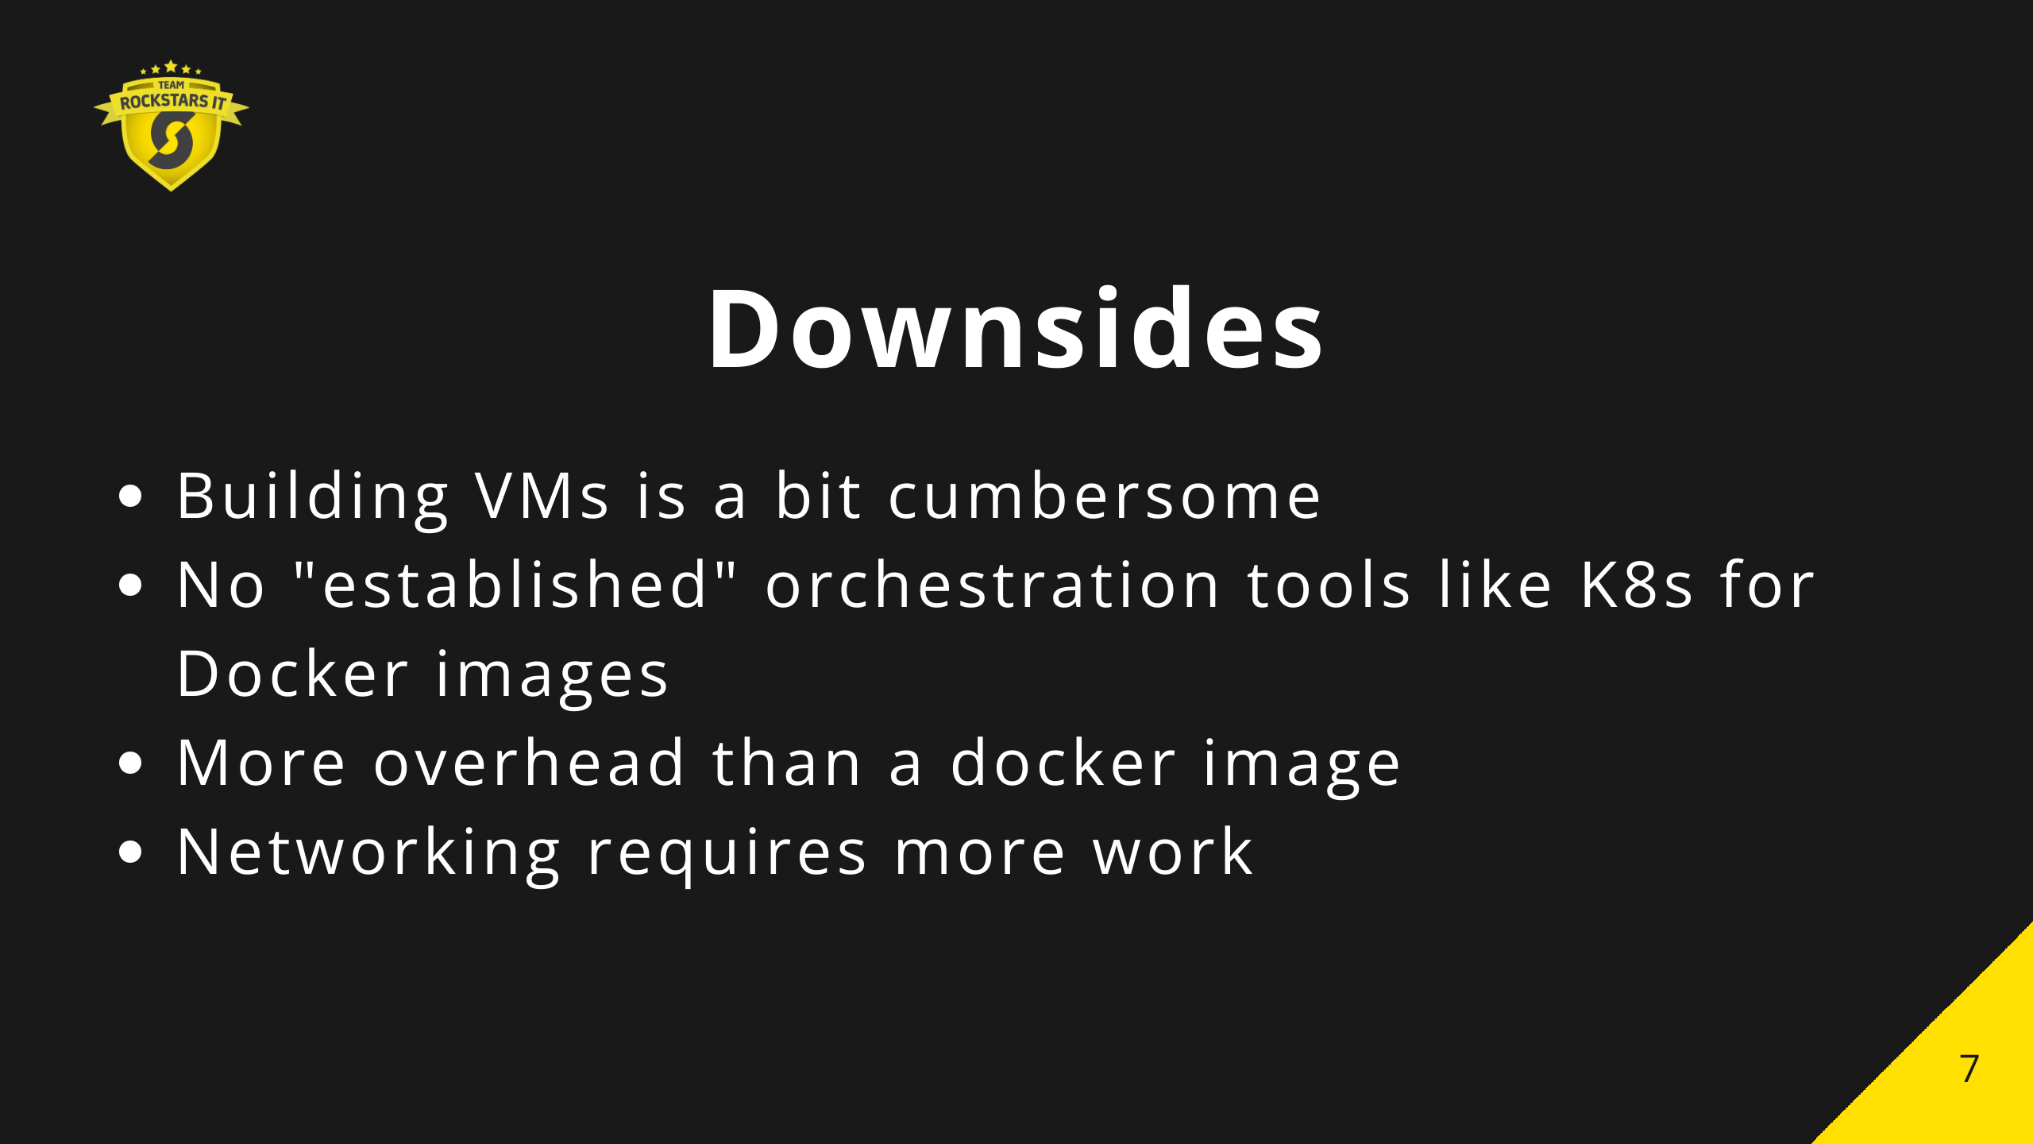

Slide 8


Slide 9


Slide 10


Slide 11


